Slide 1


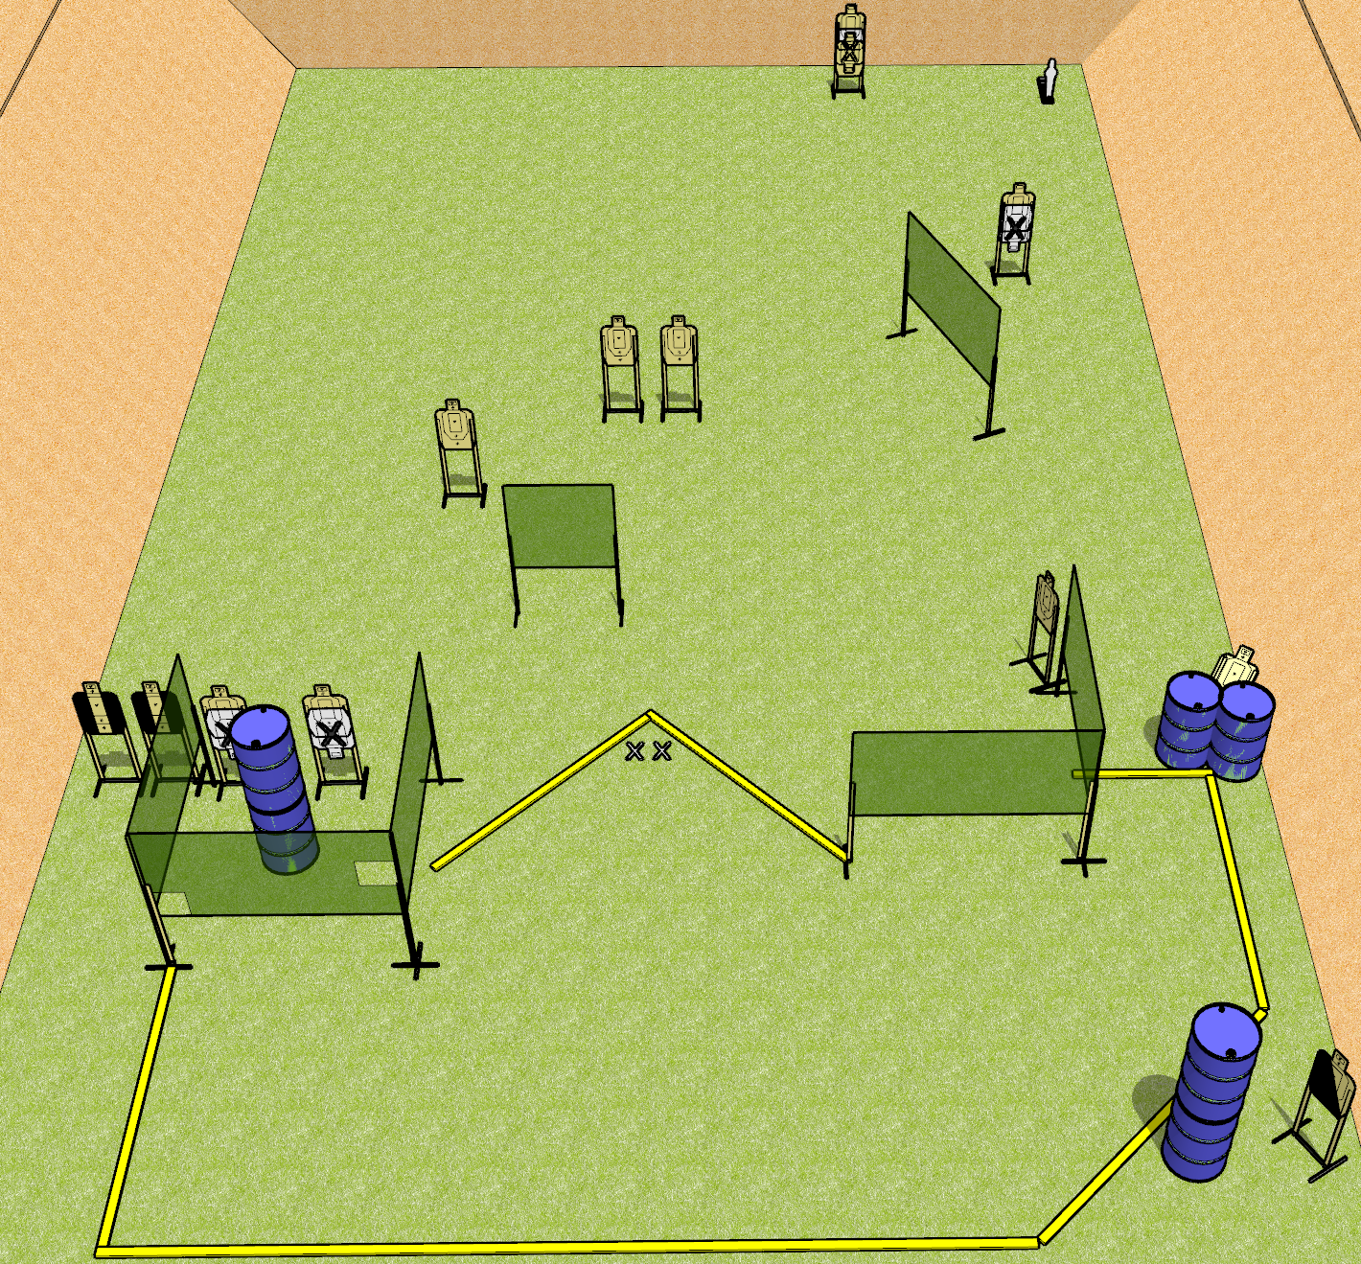
 | Dothan Gun Club – USPSA Match The Weird One Course Designer : Drew Coleman
Round Count 27 rounds 13 USPSA 1 mini popper
Equipment List 1 medium fault line 11 wall feet 2 tuxes, 1 left diagonal 14 targets (11 scoring + 3 NS)

Slide 2
The Weird One
Written Stage Briefing
The Weird One is a 27 round, 135 point, Comstock course of fire. There are 13 USPSA targets and 1 mini popper. The best 2 hits on paper will score, and steel must fall to score. The start signal is audible.
Handgun start position is toes on X’s, facing down range, wrists below belt. Handgun is loaded and holstered.
PCC start position is toes on X’s, facing down range, stock on belt. Loaded carbine is held with both hands, safety on.
On start signal, engage targets as they become available from within the shooting area.

